Slide 1

Steven Erly MPH
Brian Erly MD MPH
‘BEEFERS’

Slide 2
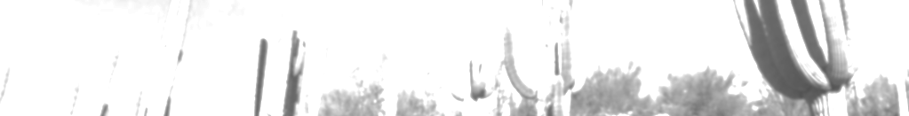
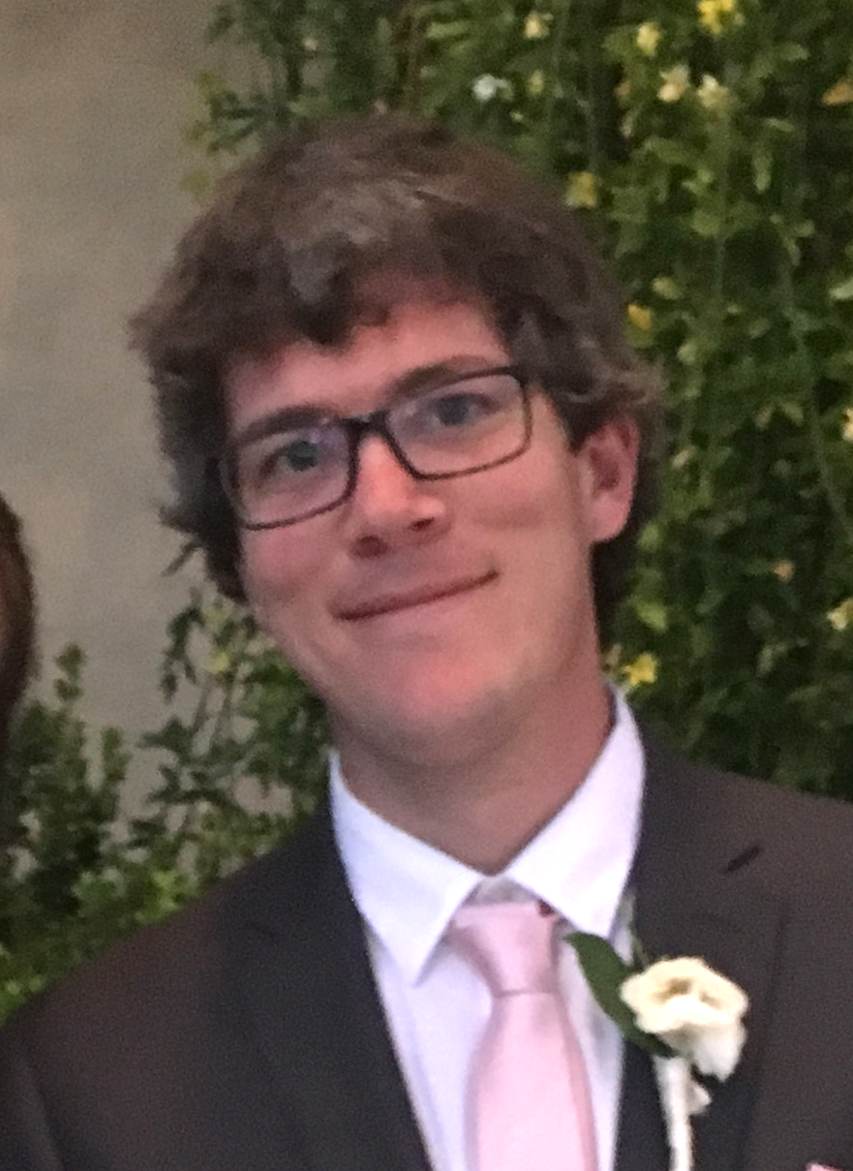

  Team: Steven Erly MPH
Washington State HIV Epidemiologist
PhD Candidate, University of Washington
MPH University of Arizona (Epidemiology)
Background
  -Statistical Analysis and Computing
  -Clinical Statistician
  -Statistical Consultant

Slide 3
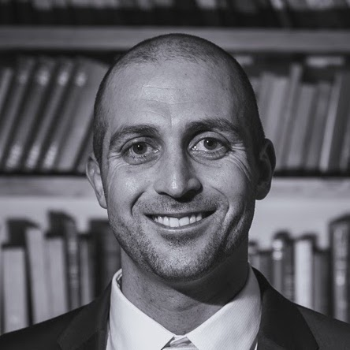
  Team: Brian Erly MD MPH
Preventive Medicine Resident, University of Colorado (HRSA Funded)
MD: Case Western Reserve University
MPH: University of Arizona
Background
-Healthcare Informatics Consultant
-Internal Medicine
-Medical Writing

Slide 4
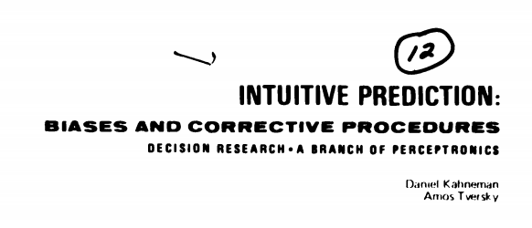
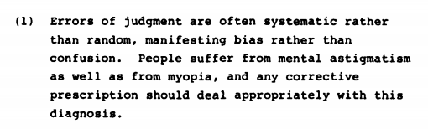
Approach
Model cognitive bias in crowd forecast instead of individual domain content
  Robustness
  Efficiency/Scalability
Inclusion of factors that may affect cognitive bias
  Web traffic
  Optimism
  Residual factors
Notes:
There are no significant differences between the judgmental processes of experts, intelligence analysts, and physicians, to cite but a few, confirm the presence of common biases in the professional judgments of experts.
(3) Erroneous intuitions resemble visual illusions in a crucial respect: both types of error remain ACs1014 "i compellingly attractive even when the person is DOC r;sectm J3 fully aware of their nature. In situations UNANNOUN kely to produce illusions of sight or intuition,
we must let our beliefs and actions be guided by a critical and reflective assessment of reality, rather than by our immediate impressions, however compelling these may be.

Slide 5
Approach
Tiered Model Systems
  Optimization and comparison of prediction dimensions:
    Precision
    Timeliness
    Flexibility
  Multiple models per tier
    Optimization of tuning and parameter inclusion
Precision
Timeliness
Flexibility

Slide 6
Tier 1: Gradient Boosted Decision Tree (High Precision)
Forecast
“Optimism” dimensionality
Social media interest
Gradient boosted decision tree
Expert predictions
Prediction

Slide 7
Tier 1
Question | Ans. 1 | Ans. 2 | Ans. 3 | Ans. 4 | Ans. 5
What will be the long-term interest rate for Greece? | < 4.15 | 4.15 — 4.73 | > 4.73
Closing price of gold in USD? | > $1,456 | < $1,221 | $1,221 — $1,303 | $1,303 — $1,374 | $1,374 — $1,456
Will a sovereign nation launch a ballistic missile at North Korea? | Yes, and the missile struck within North Korea’s borders | Yes, and the missile’s flight path was interrupted or went astray | No
Shortfalls
  Model unable to accommodate diversity of question structure.
  High degrees of freedom and limited IFPs
  Manual data management slowed predictions

Slide 8
Tier 2: Raw Decision Tree
Automation of IFP predictions
Lower sample size requirement as compared to adjusted gradient boosting models
Assumption implicit dimensionality of IFP Results
    - E.g. option #4 has meaning
Timeliness
Precision

Slide 9
Tier 3: Constant Bias Model
Maximize Timeliness
Flexible to changes in question structure
Assumes stable cognitive biases

Slide 10
Performance
Best Model: Tier 3 with negative tariffs
  Overcompensation for cognitive bias in forecast models
Best performance in politics and international relations
Worst performance in macroeconomics/ finance
  Distinct sources of bias?
Domain | Questions Attempted | % Positive
All | 157 (95%) | 54.25%
Politics/International Relations | 94 (96%) | 63.04%
Natural Sciences/Climate | 157 (95%) | 54.25%
Health/Disease | 9 (90%) | 55.56%
Macroeconomics/Finance | 48 (96%) | 39.58%

Slide 11
Takeaways
Successful model was low-dimensional and was able to incorporate information quickly.
In real-world prediction, large amounts of data may not be available.
Timeliness of information is critical

Slide 12
Future Directions
Characterization of variability in the effect of cognitive bias on aggregate prediction in a variety of settings:
-Domain
-Prediction environment
-Predictor population
Retrospective ML modelling of ideal bias tariff.
Brian Erly MD MPH
Machine image recognition software for tele-dermatology research
Endocarditis surveillance system for CO
Lab aberration detection for reportable diseases
Steven Erly MPH
PhD at U. Washington
HIV surveillance system for WA

Slide 13
Thank you!
Steven Erly
serly@uw.edu
520-269-0345
Brian Erly
brianerly@gmail.com
520-404-4982
http://teambeefers.com

